Slide 1


SmartCash: The Crypto focused
on users and businesses
SMARTCASH.CC

Slide 2
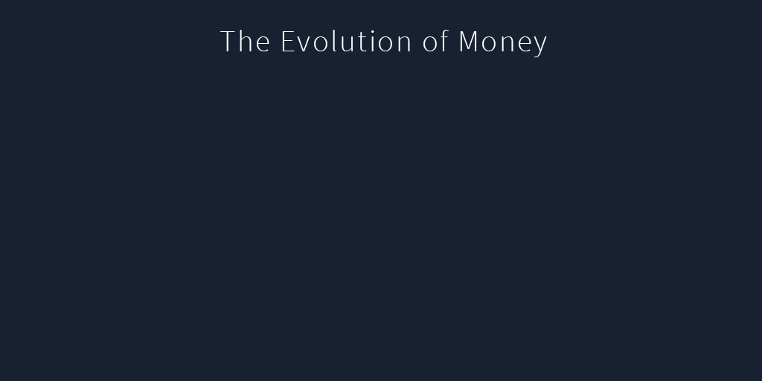
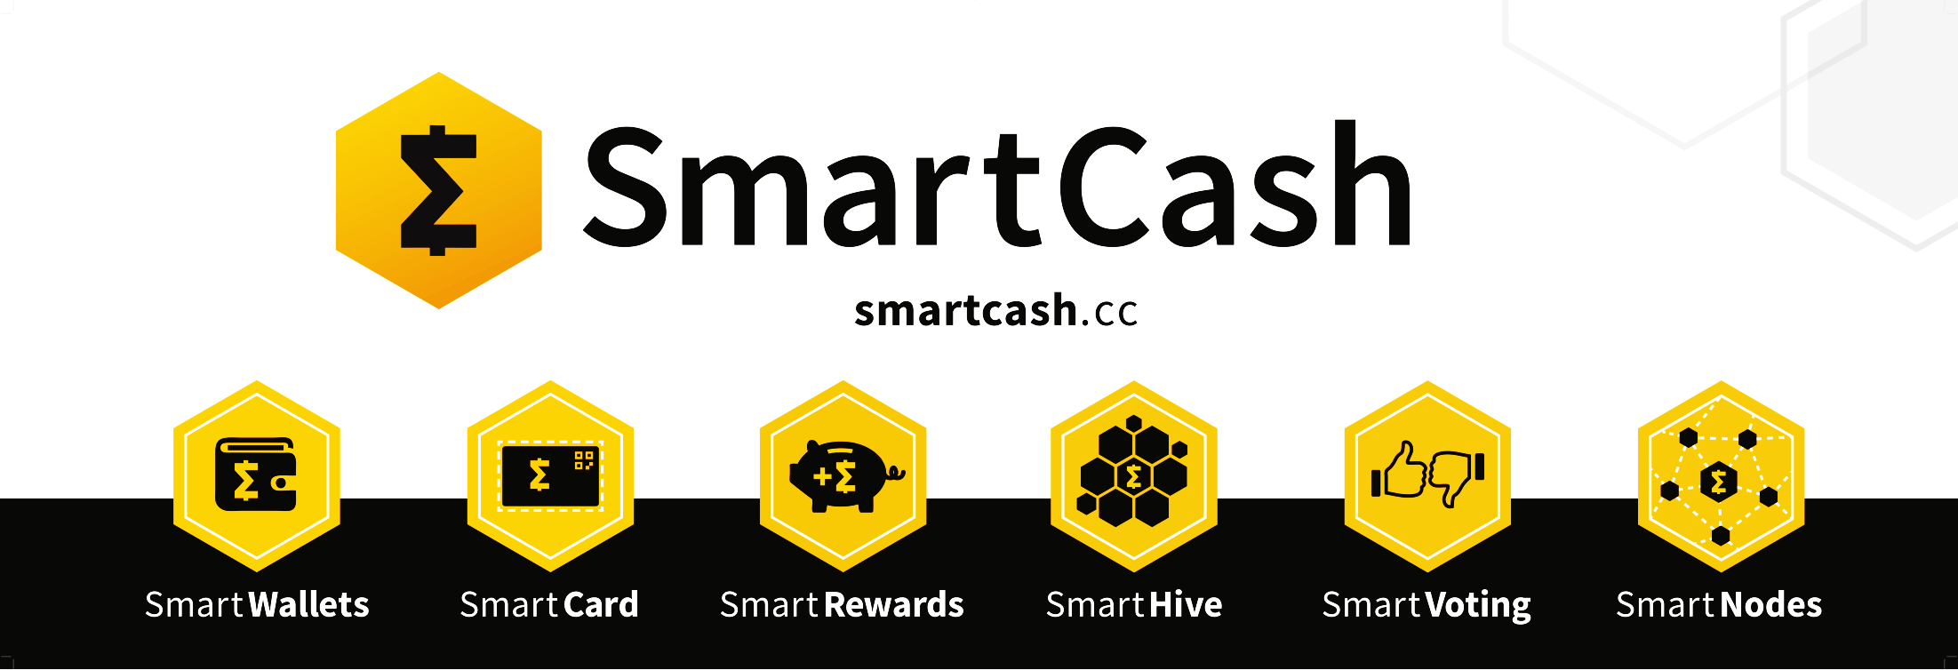

Slide 3


SmartCash is an easy to use, fast, and secure cryptocurrency that can be used for in person and online purchases.
SmartCash is positioned to replace legacy currencies with better technology.
SmartCash

Slide 4






SmatCash is a coin with its own blockchain
Launch date July 11, 2017
Blockchain consensus – POW
Mining algorithm – Keccak
Block time - 55 seconds
Maximum Supply - 5 Billion SMART
SmartCash

Slide 5
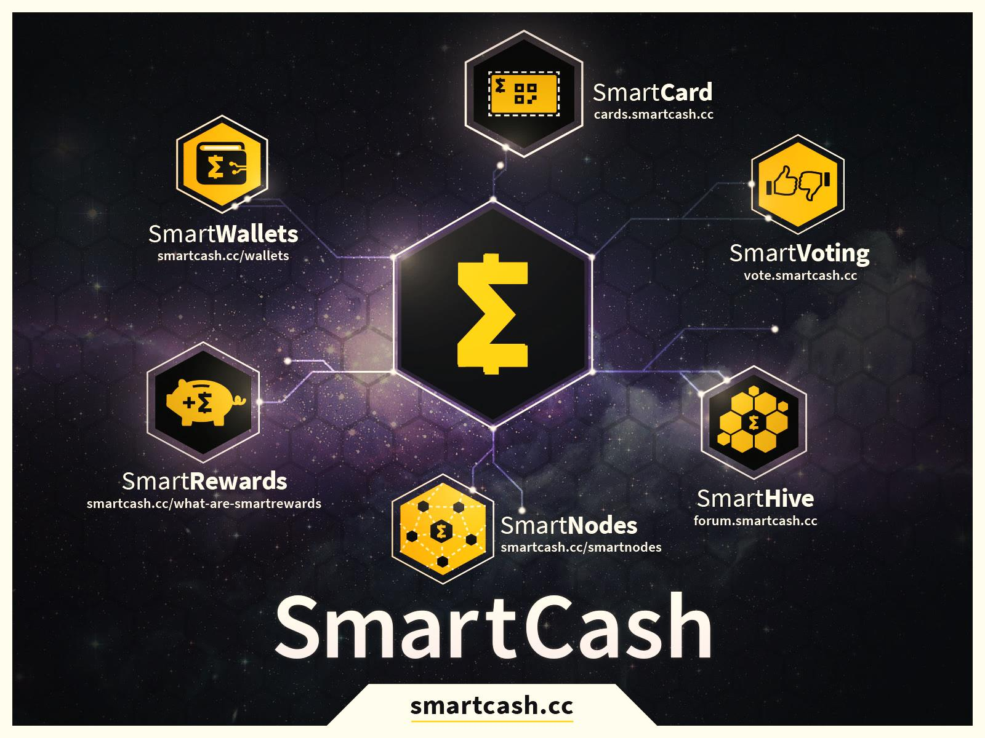


Slide 6
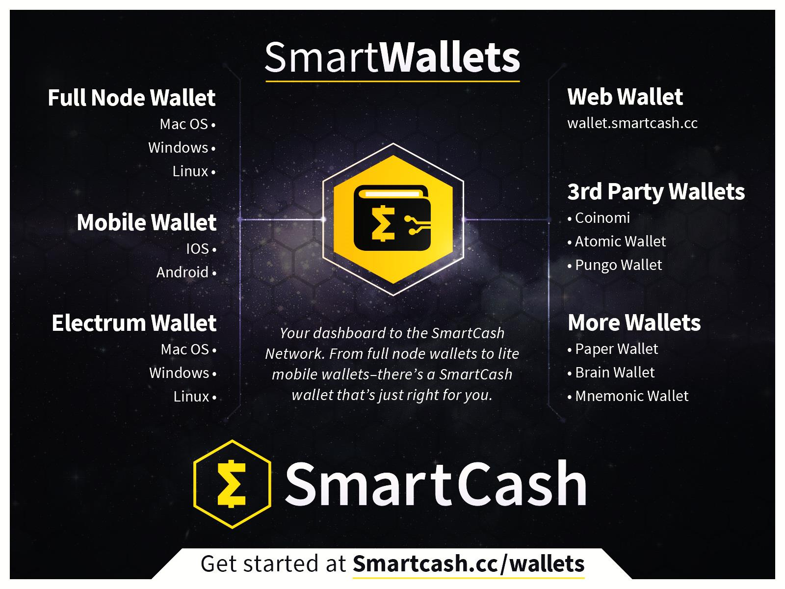

Slide 7
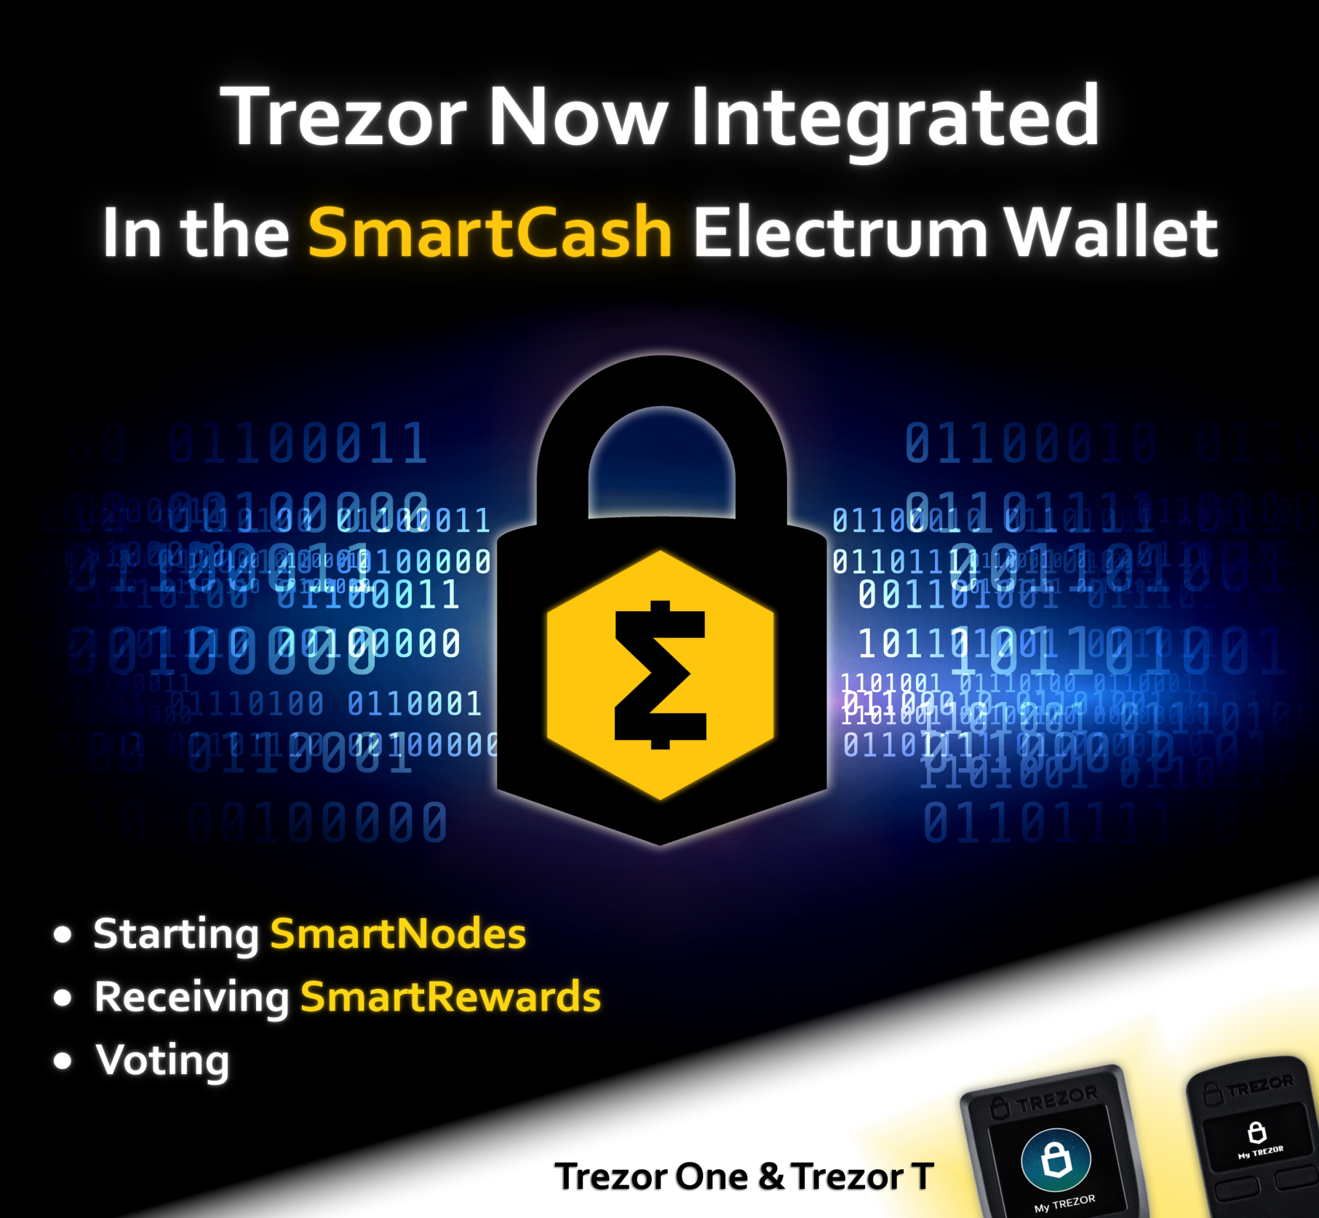


Slide 8
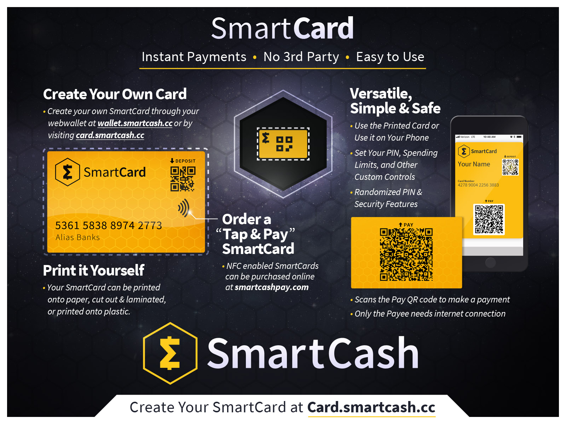

Slide 9
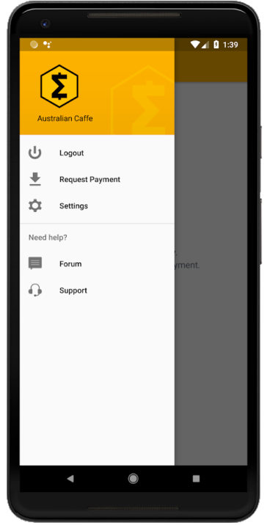
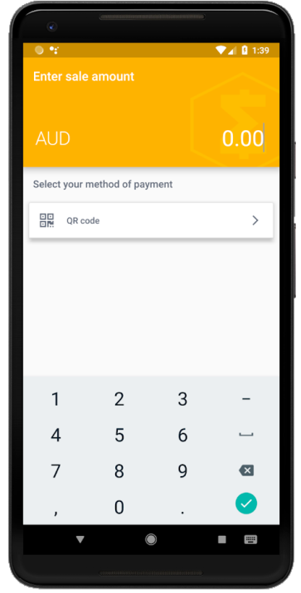
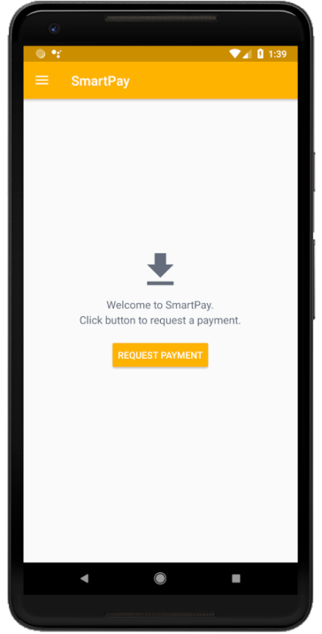
The SmartPay app is used by businesses to scan SmartCards. Accept SmartCash as a payment option with zero fees with a simple app available for Android devices.
SmartPay

Slide 10
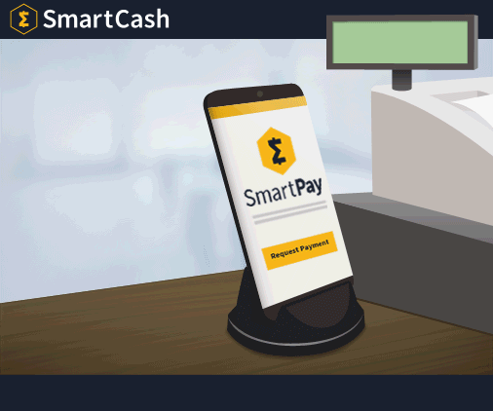

Slide 11

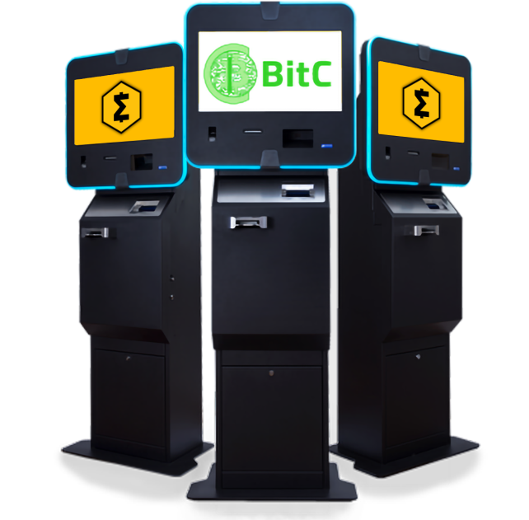
SmartCash is now available at 11 BitC ATM locations throughout Switzerland!
ATM locations

Slide 12
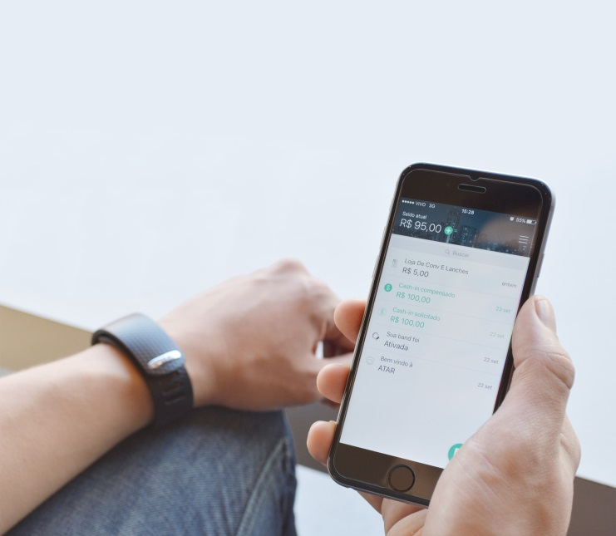
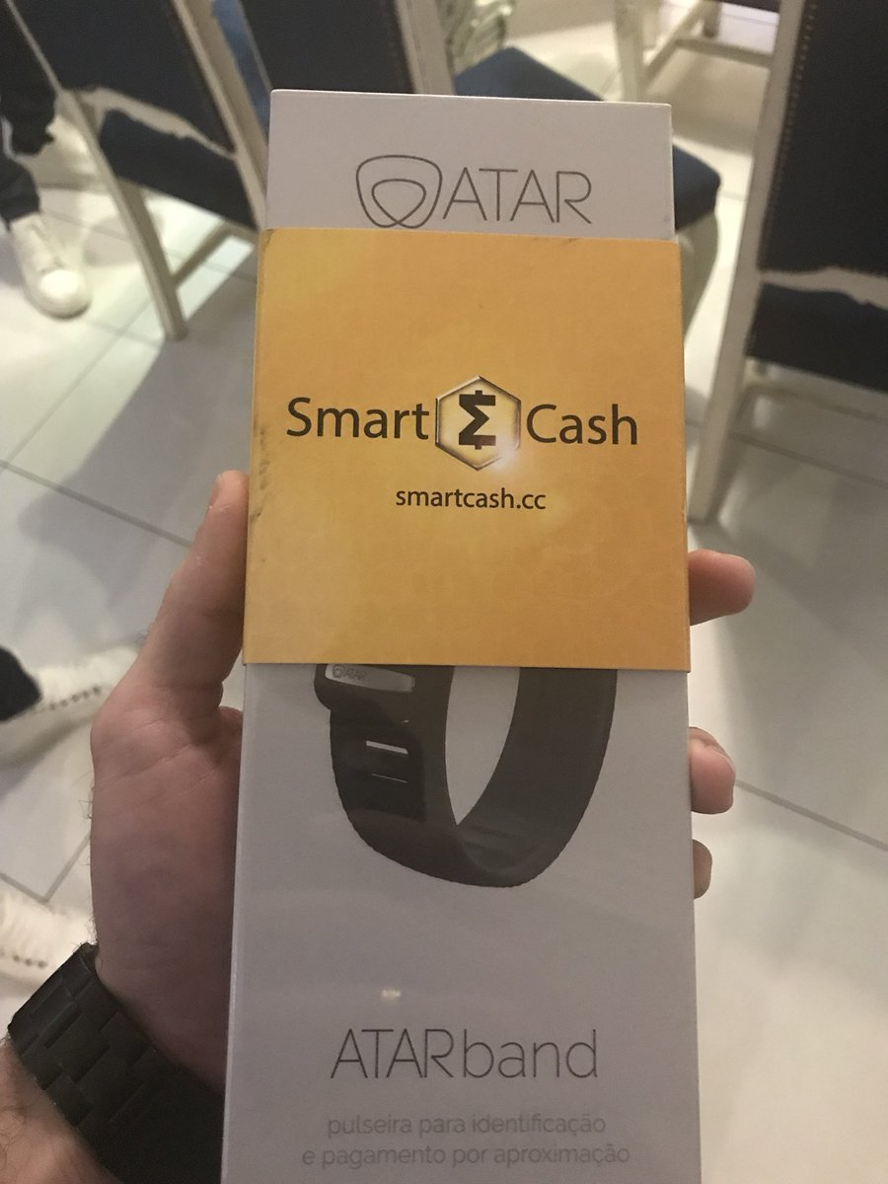
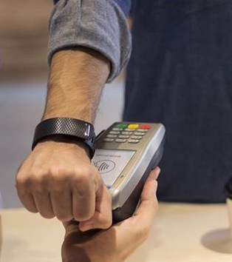
SmartBand

Slide 13
Buy any thing with your SmartBand
SmartBand is a bracelet with NFC chip. Partnership between Stratum, ATAR, and SmartCash.
Works across Brazil
You can buy SmartCash and load your SmartBand at any regular store using their existing system. The SmartBand is available to purchase from WearAtar, and works at 85% (2.5 million points) of retailers in Brazil already!
SmartBand

Slide 14

Store funds safe on
SmartCash Vault
SmartCash introduces the Vault feature on the webwallet. Move funds into the Vault and enjoy piece of mind that your coins are safe.
SmartCash Vault
Features:
1-3 day waiting period
Email before withdrawing

Slide 15
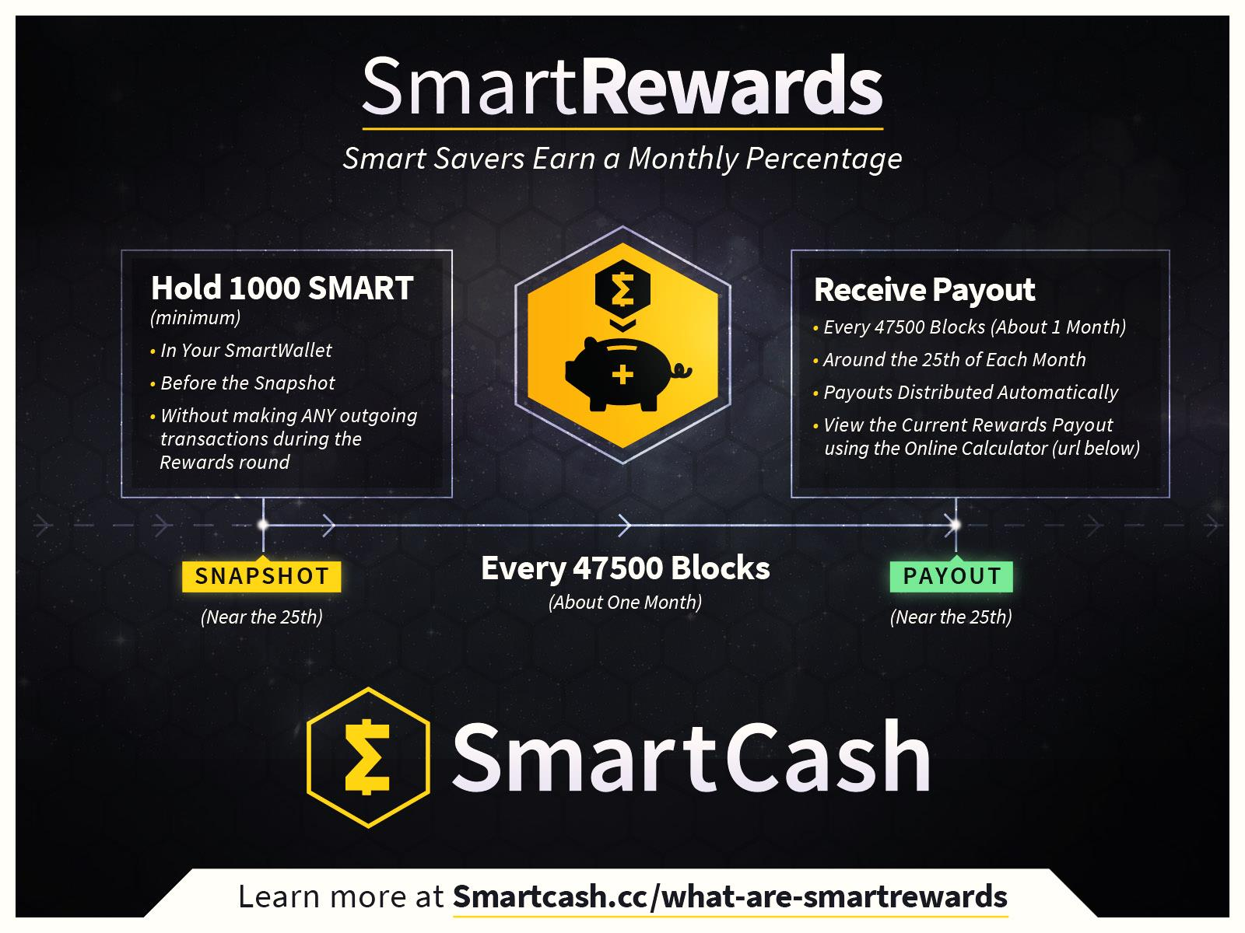

Slide 16
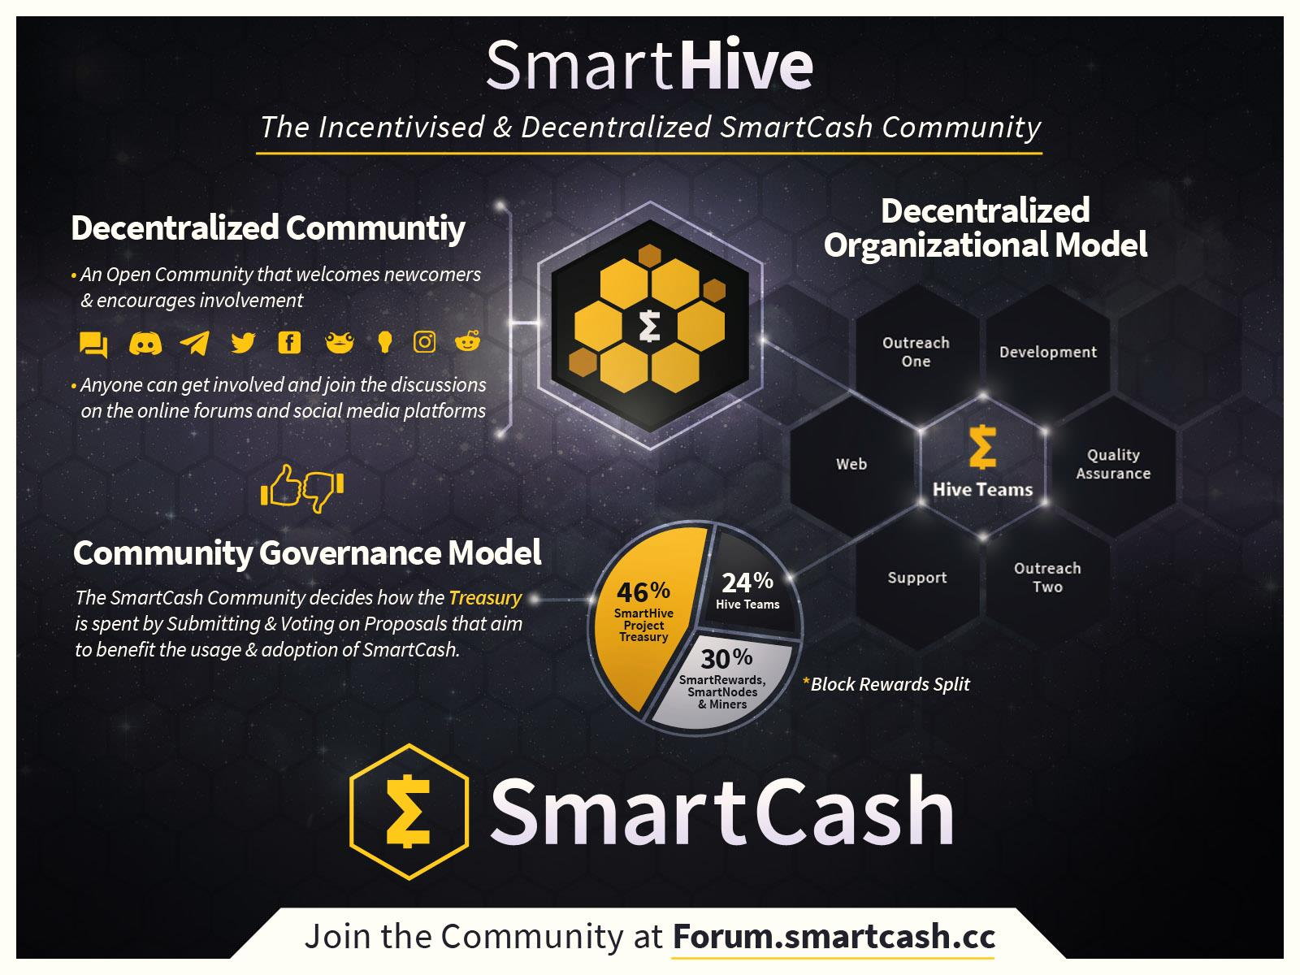

Slide 17
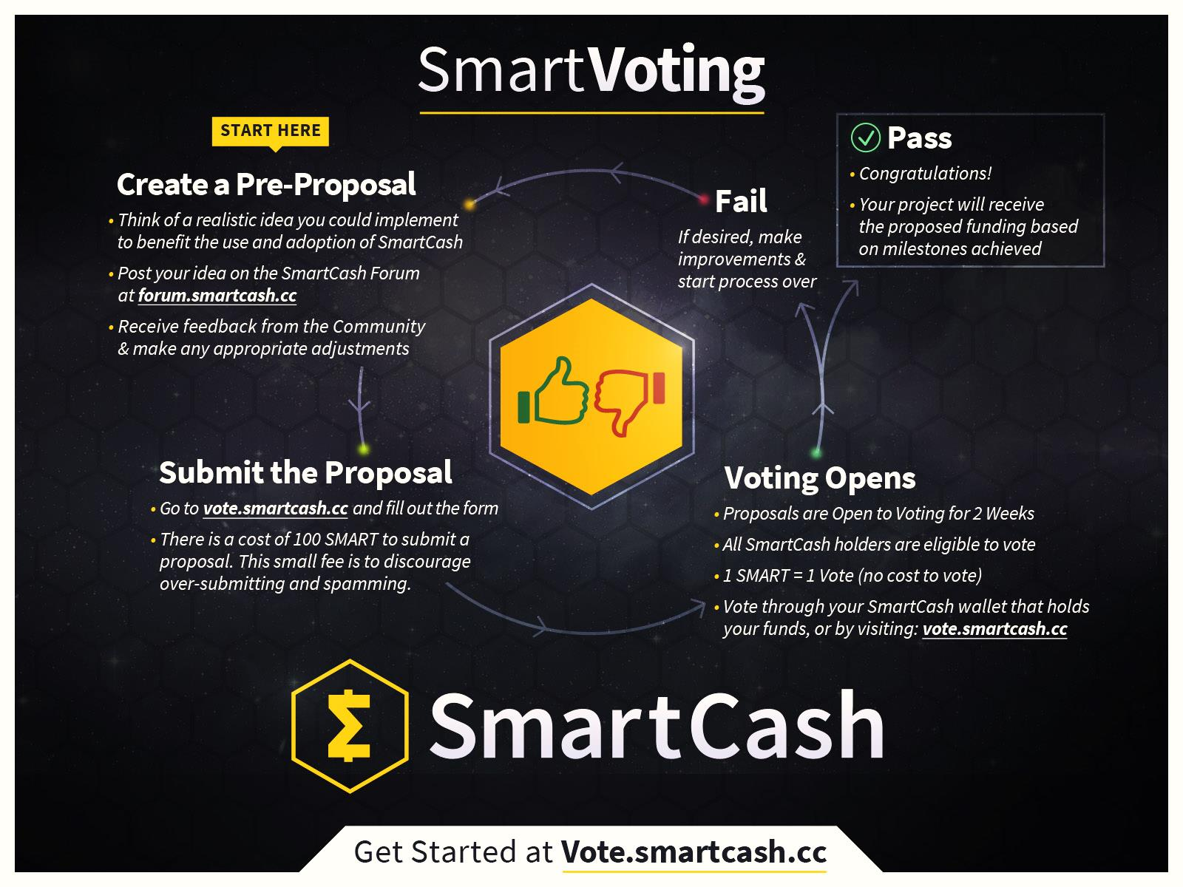

Slide 18

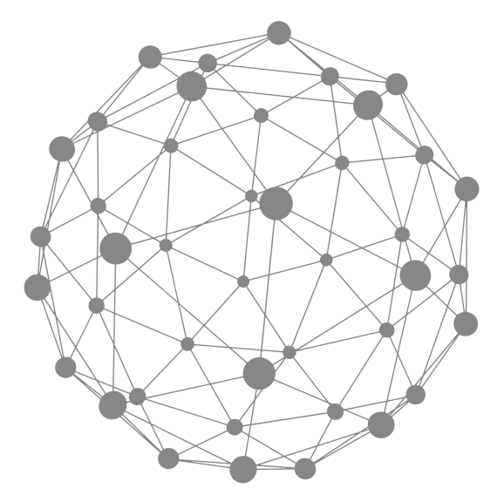

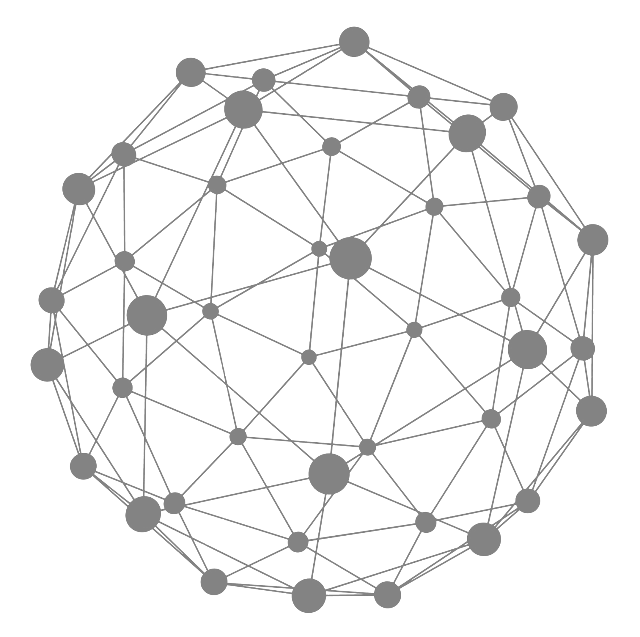
SmartNodes
SmartNodes are servers that run a
SmartCash wallet and enable the next generation features to be added. One
of the key features is InstantPay, which enables transactions to be locked in
about a second and allows
instant point-of-sale
in-store and online
purchases.
SmartNodes

Slide 19

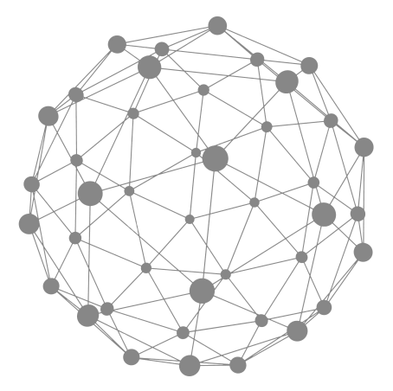





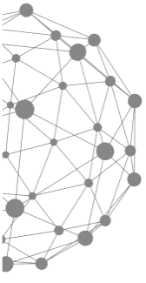

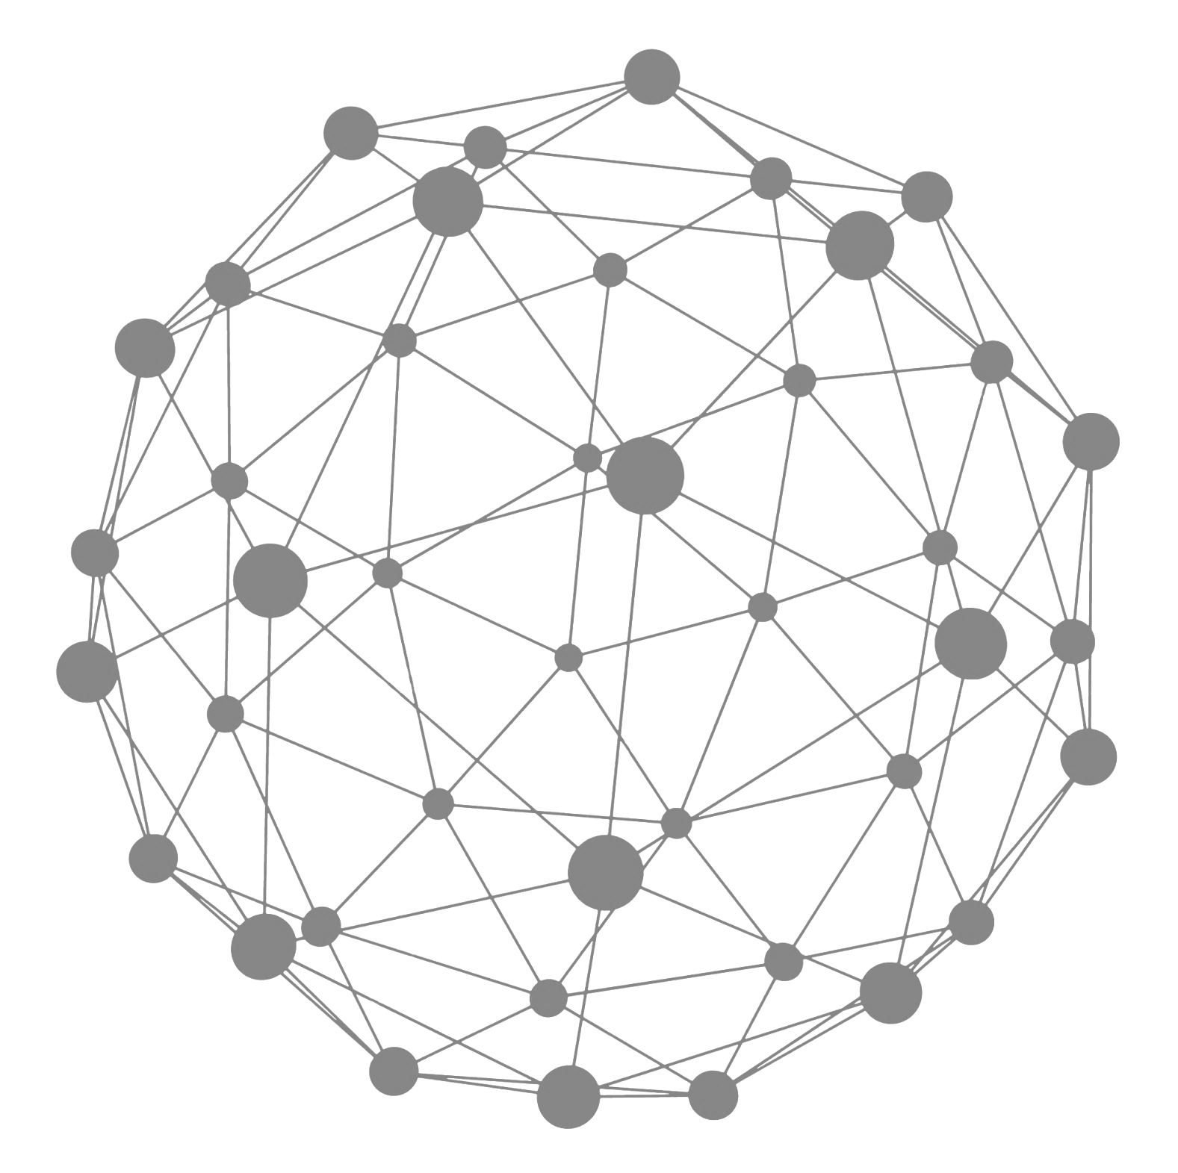
InstantPay
Speed of transactions is a key feature of SmartCash. InstantPay allows instant point-of-sale in-store and online purchases.
Allows for SmartCash transactions to be locked in about a second.
No risk of double spending a transaction, so the receiver can trust that transaction immediately.
InstantPay

Slide 20

Benefits of accepting cryptocurrency
Advantages
No 3rd Party Instant Payment 0% fees
Full Control Add Your Locations Android App

Slide 21


How to Start?
If you run an online business - sign up on CoinPayments. Then go to SmartCash.cc, here you can find a guide on how to configure your e-commerce platform to integrate with this payment type.
For stores that do sales and
transactions in-person - you can
use simple SmartPay app.
Advantages

Slide 22








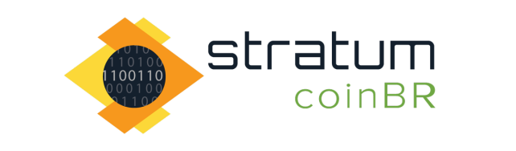
Use SmartCash everywhere!
All over the World!

Slide 23
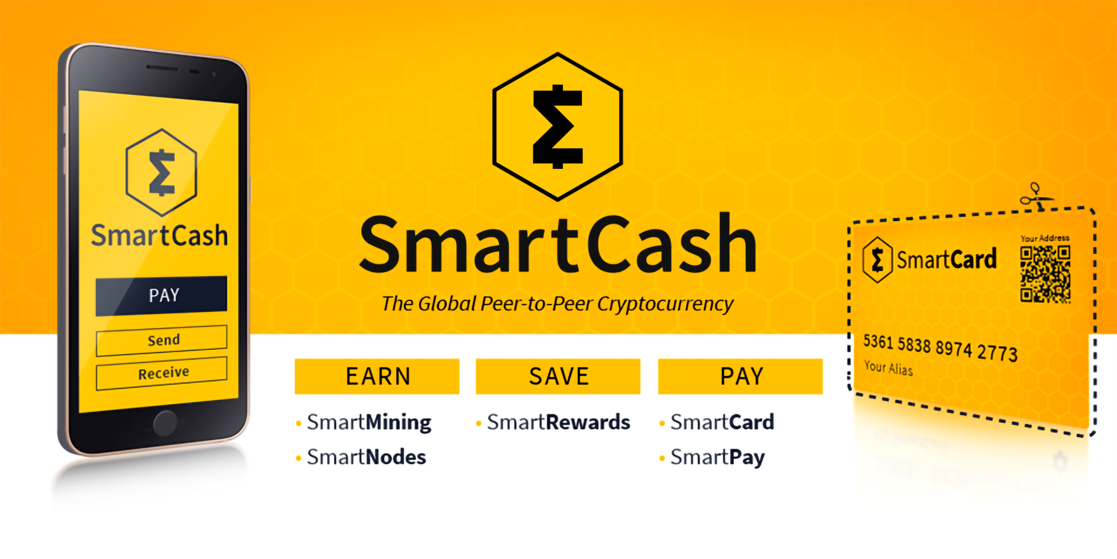




Join the SmartCash Community!
@scashofficial discord.smartcash.cc
smartcashchat hello@smartcash.cc

